Slide 1

MADAN MOHAN MALAVIYA UNIVERSITY OF TECHNOLOGY - GORAKHPUR
DEPARTMENT OF COMPUTER SCIENCE AND ENGINEERING
Session : 2023-2024
HEART DISEASE PREDICTION SYSTEM USING MACHINE LEARNING
PRESENTED BY -
AMAN MATHUR(2020021023)
ARNISH VERMA (2020021031)
KISHAN KUMAR JAISWAL(2020021071)
UNDER THE GUIDANCE OF -
MR. SUSHIL KUMAR SAROJ
ASSISSTANT PROFESSOR
DEPT. OF CSE, MMMUT

Slide 2
TABLE OF CONTENTS
S. No. | CONTENT
1. | ABSTRACT
2. | LITERATURE SURVEY
3. | PROBLEM DEFINITION
4. | SOLUTION STRATERGY
5. | METHODOLOGY
6. | IMPLEMENTATION
7. | RESULTS
8. | CONCLUSION

Slide 3
INTRODUCTION
Heart diseases is a term covering any disorder of the heart.
Studies show that the number of deaths due to heart diseases have increased significantly over the past few decades. Thus, preventing Heart diseases has become more than necessary.
Good data-driven systems for predicting heart diseases can improve the entire research and prevention process.
A person dies in every 33 seconds in the United States from heart related disease.
Cardiovascular diseases (CVDs) are the leading cause of death globally, taking an estimated 17.9 million lives each year. The annual number of deaths from CVD in India is projected to rise from 2.26 million (1990) to 4.77 million (2020). Coronary heart disease prevalence rates in India have been estimated over the past several decades and have ranged from 1.6% to 7.4% in rural populations and from 1% to 13.2% in urban population.

Slide 4
The number of deaths due to heart attacks in India has remained consistently over 25000 in the last 4 years and over 28000 in last 3 years.
We should talk more about preserving heart health. In India, cardiovascular diseases account for more than 26 per cent of all deaths. Poor heart health is a leading cause of shortening of lifespan and increasing mortality rates.
This project contributes to the growing body of knowledge in the field of cardiovascular diseases and underscores the importance of personalized medicine and preventive healthcare. As we strive to mitigate the burden of CVDs on global health, our work provides valuable insights for researchers, healthcare professionals, and policymakers alike, fostering informed decision-making and targeted interventions.

Slide 5
ABSTRACT
This final year project is centered around the creation and implementation of a heart disease prediction system utilizing cutting-edge Artificial Intelligence (AI) and Machine Learning (ML) techniques.
The methodology involves the integration of a comprehensive dataset encompassing diverse patient profiles, clinical attributes, and historical health-data. Heart Disease dataset has some non-linear tendency.
Improvement on Heart Disease Prediction technique by correctly adjusting the Random Forest Machine Learning Model (fetching 85.81% accuracy).
Health care data contains hidden information which is useful for making effective decisions.
Insights from this project are significant for shaping future personalized preventive healthcare strategies. This can help patients in getting a quick diagnosis with a lot less cost.

Slide 6
LITERATURE SURVEY
S.No. | Title | Authors | Methodologies | Limitations
1. | An Artificial Neural Network Model for Neonatal Disease Diagnosis | Dilip Roy Chowdhury, Mridula Chatterjee, R.K. Samanta | Multi-Layered Perceptron | They used 94 attributes(which is a great number) to train the NN which gives a lesser accuracy of 75%
2. | Comparative Study of Data Mining Classification Methods in Cardiovascular Disease Prediction | Milan Kumari, Sunila Godara | Decision Tree, Artificial Neural Network | Accuracy was closer to 80 % which could be improved
3. | Decision Support System for Heart Disease Diagnosis using Neural Network | Niti Guru, Anil Dahiya, Navin Rajpal | Neural Network | Only 78 instances were used to train neural network which tends to be less effective.

Slide 7
PROBLEM DEFINITION
WHO has estimated that Cardiovascular diseases (CVDs) are the leading cause of death globally, taking an estimated 17.9 million lives each year.
Developing a model to detect heart disease early is challenging due to the subtle and complex nature of early symptoms, making it difficult to identify patterns.
Millions of health-related data being generated every day which is difficult to be analyzed.
Integrate clinical, lifestyle, and genetic data for comprehensive heart disease prediction is challenging.
Huge amount of time and cost is required to detect heart disease.
Developing personalized treatment recommendations is challenging due to the need for models that consider individual preferences, responses to treatment, and lifestyle factors.

Slide 8
SOLUTION STRATEGY
Collecting Dataset: Gather diverse health data for heart disease prediction.
Selecting Attributes: Choose key features for accurate prediction.
Preprocessing: Clean and enhance data for reliability.
Apply Algorithms: Use suitable ML methods for heart disease prediction.
Cross-Validation: Assess model performance across data subsets.
Evaluate Accuracy: Measure algorithm precision against actual outcomes.

Slide 9
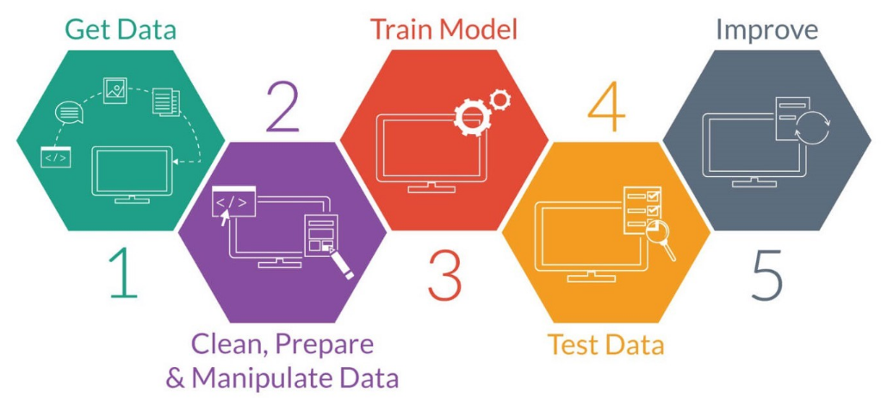
CONCEPTUAL MODEL
Fig 1: Structure of conceptual model

Slide 10
METHODLOGY
Machine learning algorithms used (using skicit-learn library of python):
Linear Regression
Logistic Regression
Support Vector Machine
Decision Tree
Random Forest
Cross Validation Techniques used:
3-fold
5-fold
10-fold

Slide 11
IMPLEMENTATION DETAILS (Steps)
Start
Collect the dataset.
Select the dependent attribute.
Preprocess the data.
Analyze dataset for different type of machine learning algorithm.
If supervised(labeled the data with input output pairs) :
6.1. Create training set and testing set using 10-fold cross-validation.
6.2. Apply supervised learning algorithm.
6.3 Do testing using the test set.
6.4. Show the accuracy.
7. Stop

Slide 12
IMPLEMENTATION
Start
Get dataset
Create training set and testing set
Preprocess dataset
(replace missing value, etc.)
Apply Supervised Learning Algorithm
Analyze dataset for different type of Machine Learning Algorithm
Do cross-validation
Show the accuracy
No
If supervised
?
Yes
Stop
Fig 2 : Flow Chart of implementation

Slide 13
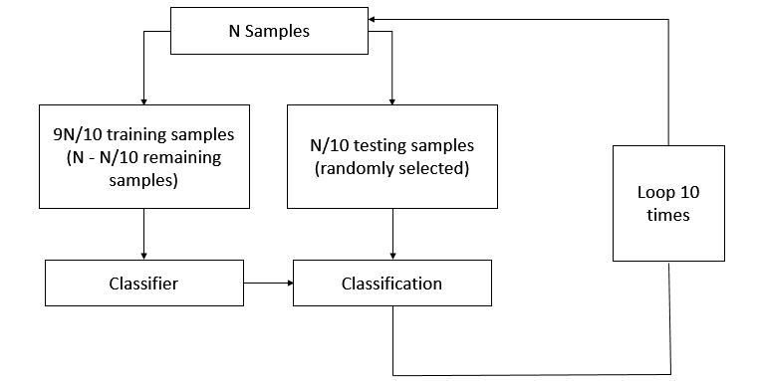
VALIDATION TECHNIQUE
Fig 3: Block diagram of 10-fold cross validation

Slide 14
10-FOLD CROSS VALIDATION
Data points of 303 instances are randomly assigned to 10 sets (approximately 30 instance in each dataset) d₀, d₁,…, d₉ so that all the 10 sets are equal in size.
We then train on d₀, d₁,…, d₈ and test on d₉, train on d₀, d₁,..., d₉ (except d₈) and test on d₈ , similarly followed by testing every single set.
Iteration No. | Training Set | Testing Set
1. | d₁,d₂,d₃,d₄,d₅,d₆,d₇,d₈,d₉ | d₀
2. | d₀,d₂,d₃,d₄,d₅,d₆,d₇,d₈,d₉ | d₁
3. | d₀,d₁,d₃,d₄,d₅,d₆,d₇,d₈,d₉ | d₂
4. | d₀,d₁,d₂,d₄,d₅,d₆,d₇,d₈,d₉ | d₃
5. | d₀,d₁,d₂,d₃,d₅,d₆,d₇,d₈,d₉ | d₄
6. | d₀,d₁,d₂,d₃,d₄,d₆,d₇,d₈,d₉ | d₅
7. | d₀,d₁,d₂,d₃,d₄,d₅,d₇,d₈,d₉ | d₆
8. | d₀,d₁,d₂,d₃,d₄,d₅,d₆,d₈,d₉ | d₇
9. | d₀,d₁,d₂,d₃,d₄,d₅,d₆,d₇,d₉ | d₈
10. | d₀,d₁,d₂,d₃,d₄,d₅,d₆,d₇,d₈ | d₉

Slide 15
ATTRIBUTES USED
The attributes used are :
age: age in years
sex: sex (1 = male; 0 = female)
cp: chest pain type
-- Value 0: typical angina
  -- Value 1: atypical angina
  -- Value 2: non-anginal pain
  -- Value 3: asymptomatic
trestbps: resting blood pressure (in mm Hg on admission to the hospital)
chol: serum cholestoral in mg/dl
fbs: (fasting blood sugar > 120 mg/dl) (1 = true; 0 = false)
restecg: resting electrocardiographic results
-- Value 0: normal
-- Value 1: having ST-T wave abnormality (T wave inversions and/or ST elevation or depression of > 0.05 mV)

Slide 16
-- Value 2: showing probable or definite left ventricular hypertrophy by Estes' criteria
thalach: maximum heart rate achieved
exang: exercise induced angina (1 = yes; 0 = no)
oldpeak = ST depression induced by exercise relative to rest
slope: the slope of the peak exercise ST segment
-- Value 0: upsloping
-- Value 1: flat
-- Value 2: downsloping
ca: number of major vessels (0-3) colored by flourosopy
thal: 0 = normal; 1 = fixed defect; 2 = reversable defect
and the label condition: 0 = no disease, 1 = disease

Slide 17
ADVANTAGES
ML spots heart disease early by analyzing patient data for subtle patterns and indicators.
ML combines health records and imaging, offering a comprehensive view of a patient's health.
Early detection and prevention cut costs by reducing the need for expensive interventions.
AI and ML strategies contribute to population-level heart disease prevention and early intervention.

Slide 18
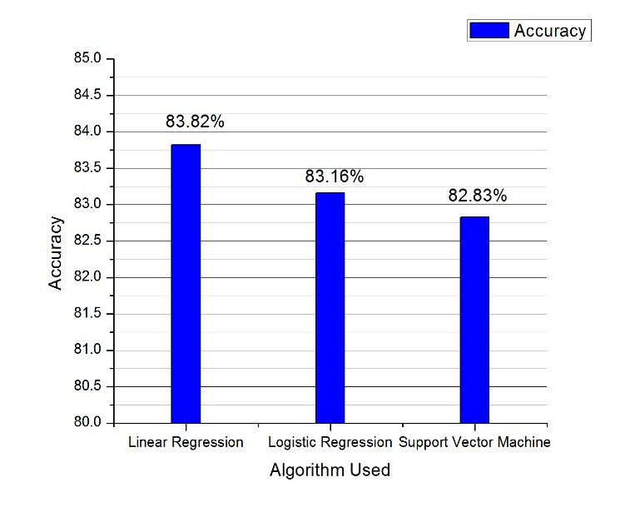
LINEAR DEPENDENCY
Fig 8: Comparison of Linear Regression, Logistic Regression and SVM showing decrease in accuracy

Slide 19
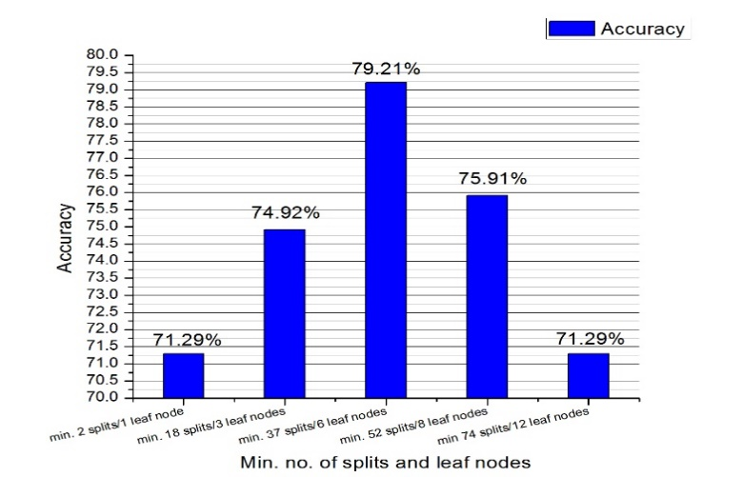
DECISION TREE
Fig 9: Accuracy obtained by varying parameters in Decision Tree

Slide 20
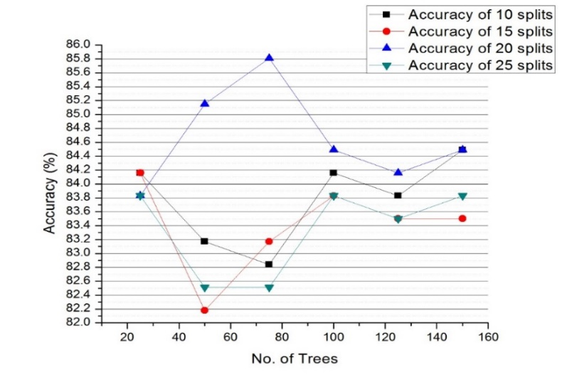
RANDOM FOREST
Fig 10: Accuracy achieved with variable number of Splits and Trees

Slide 21
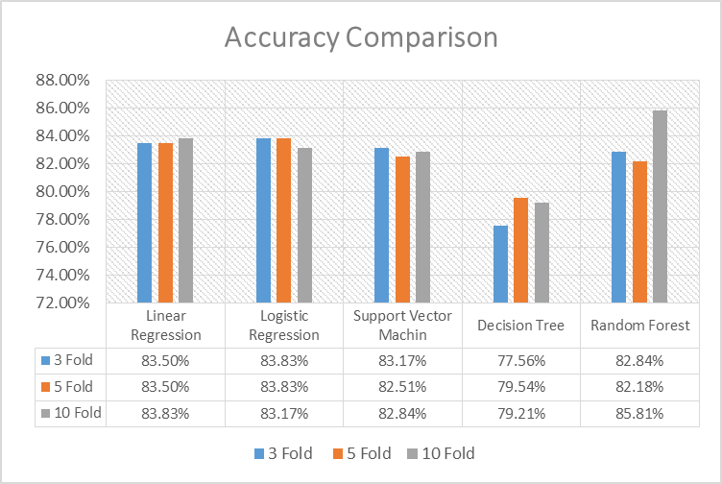
COMPARISON
Fig 11: Comparison of result with different validation
technique

Slide 22
CONCLUSION
Our dataset set has Non-Linear dependency.
By correctly adjusting the parameters of Random Forest, we were able to achieve better accuracy.
We had lesser amount of dataset so 10-fold cross-validation gave us better result.
Our solution strategy is not so Robust in nature, every time it needs a few adjustment in parameter.
The accuracy achieved is satisfactory but can be future improved.
We can use data warehouses in hospital so that the amount of data increases and a greater accuracy could be achieved.

Slide 23

THANK YOU

